Slide 1

Module 3
Advanced Multiple Linear Regression (MLR)
Notes:
Guidelines
Use section headers to chunk content in your presentation.
Use the same style of section header throughout your presentation.
Keep your title to no more than 2 lines.

Slide 2
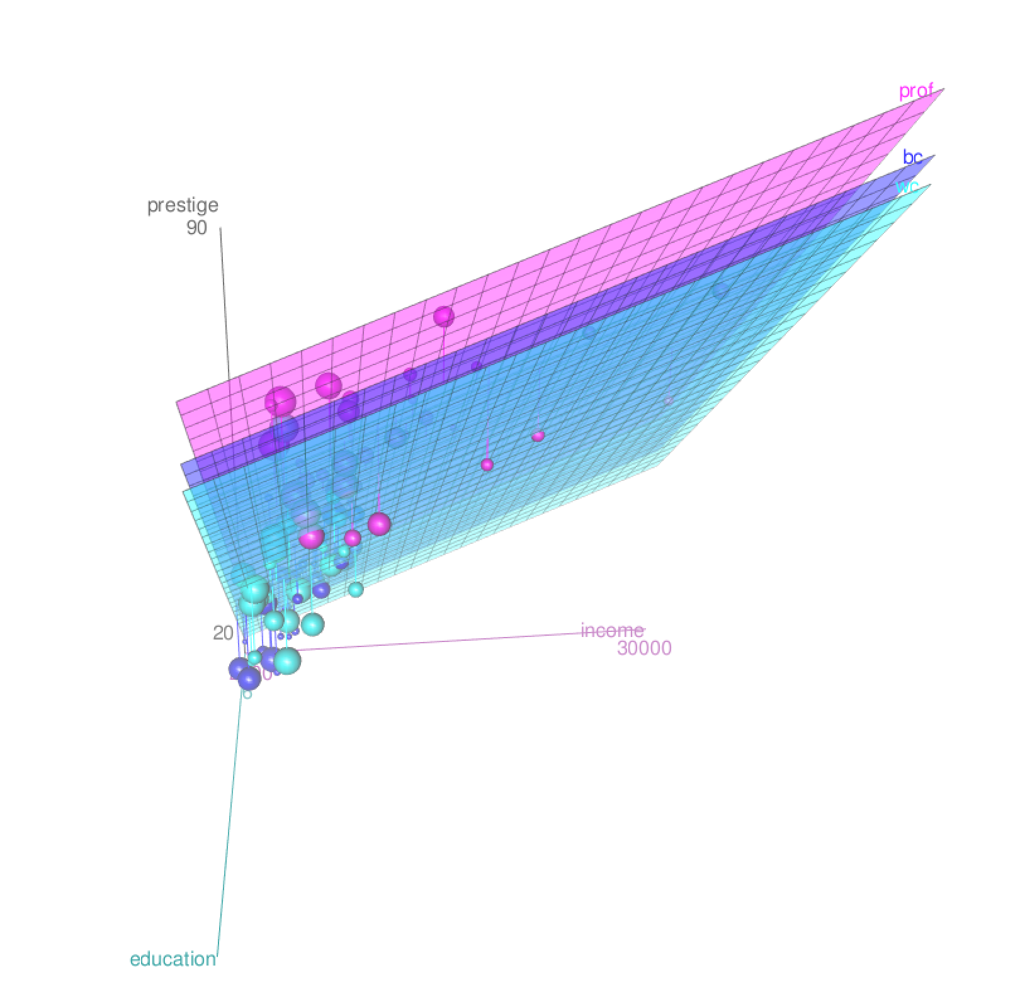
MLR with Categorical Predictors
Notes:
Guidelines
Use a title slide at the beginning of your presentation. There are 9 variations of title slides to choose from.
If you will have a series of slideshows, we recommend using the same style of title slide for each presentation.
Keep your title to no more than 2 lines.
Do not change the font style or font size of the title or subtitle.

Slide 3
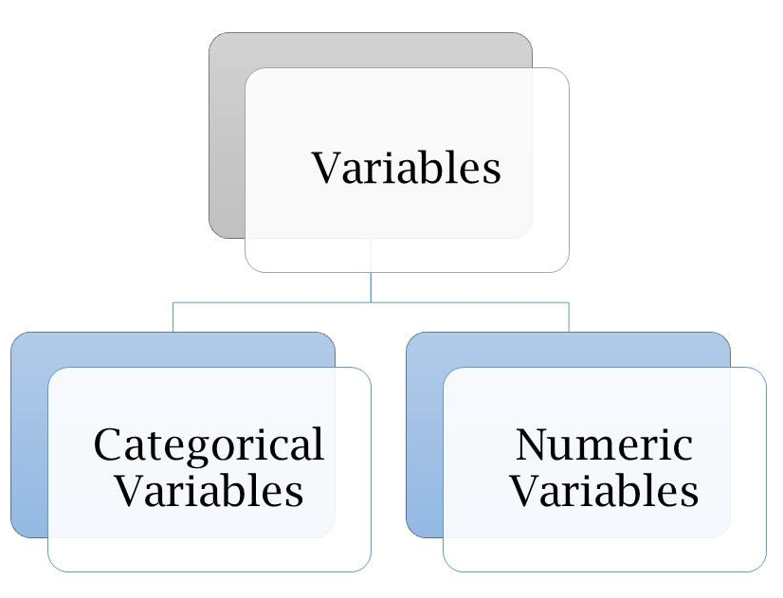
Variable Types
Quantitative (Numeric) Predictors: assume numerical values corresponding to points on a line.
Qualitative (Categorical or Factor) Predictors: have categories

Slide 4
Variable Types
We may need to correct types on real data

Slide 5
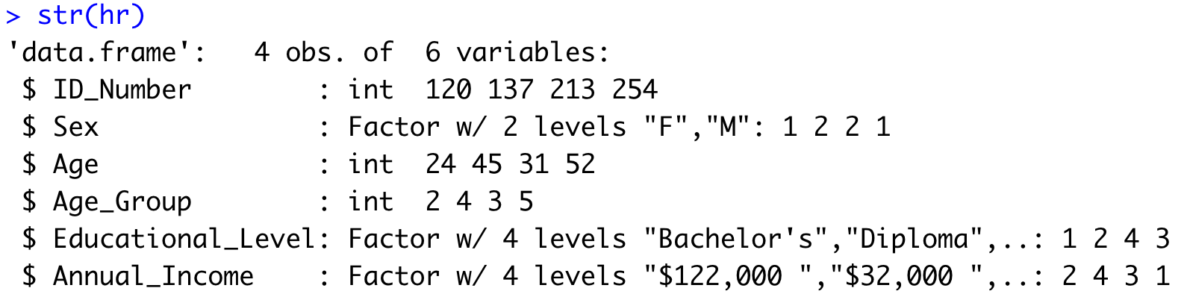
Variable Types

Slide 6
Correcting Variable Types
Changing categorical variables to numeric

Slide 7

Practice

Slide 8
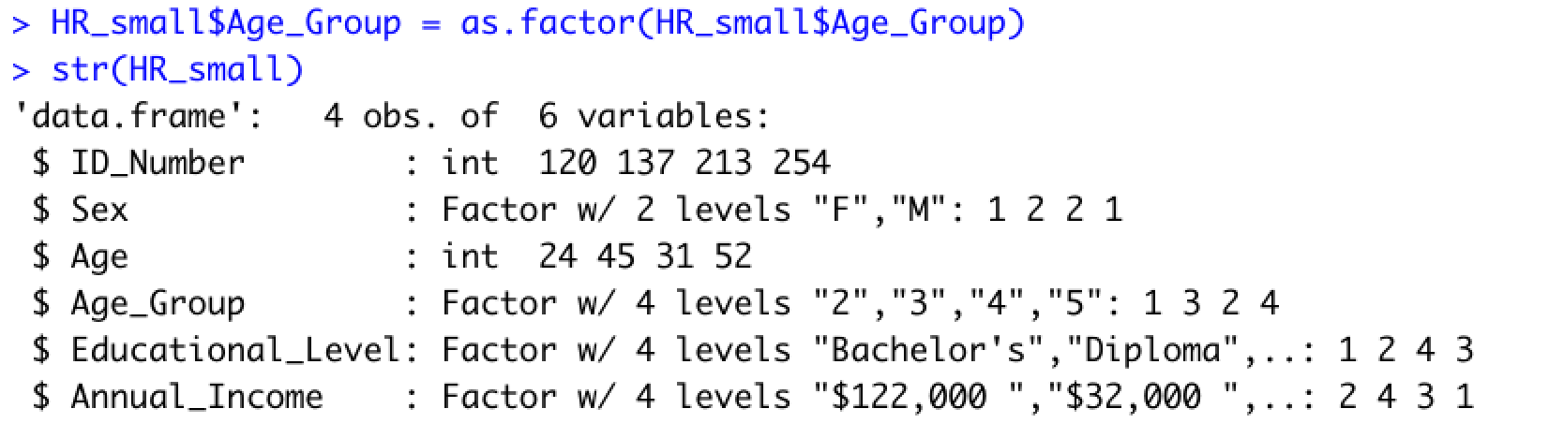
Correcting Variable Types

Slide 9
Correcting Variable Types
Changing numeric variables to categorical

Slide 10
Practice

Slide 11
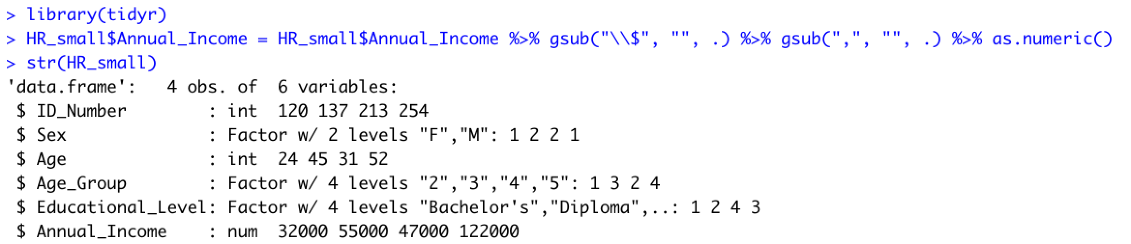
Correcting Variable Types

Slide 12
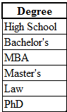
# of Levels in Categorical Variables
The Levels of a qualitative factor are defined only by the categories
6 levels

Slide 13
Practice

Slide 14
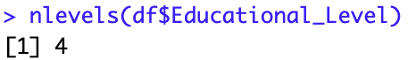
# of Levels in Categorical Variables

Slide 15
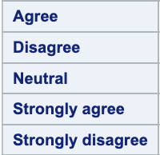
Reference Level Categorical Variables
In dummy-encoding the reference or base level is the level we want to compare other levels to.
By default most programming languages use the first (ordered) level
Default reference (base) level

Slide 16
Changing a Reference Level
We can change the reference level if needed
New reference (base) level

Slide 17
Practice

Slide 18
Changing a Reference Level
We can change the reference level if needed

Slide 19
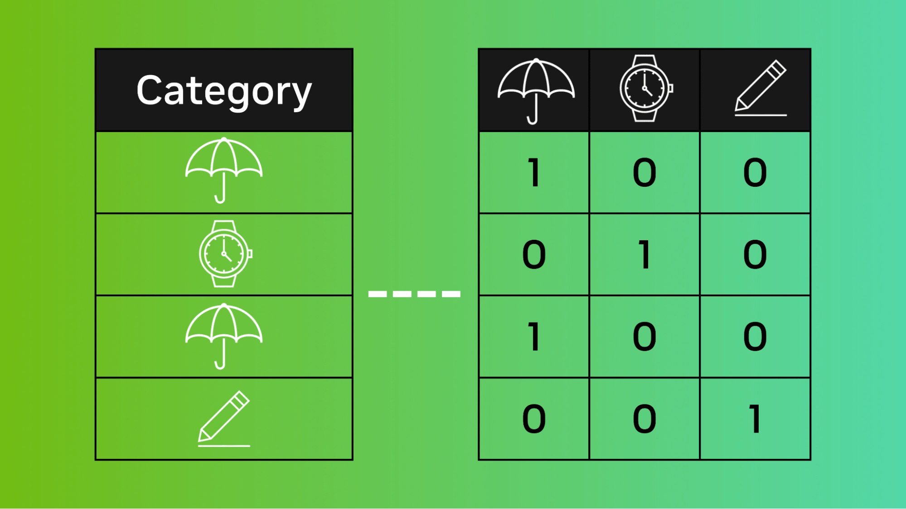
Encoding Categorical Variables
Notes:
Guidelines
Use a title slide at the beginning of your presentation. There are 9 variations of title slides to choose from.
If you will have a series of slideshows, we recommend using the same style of title slide for each presentation.
Keep your title to no more than 2 lines.
Do not change the font style or font size of the title or subtitle.

Slide 20
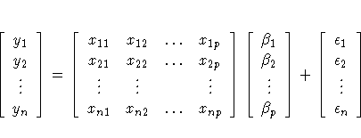
Categorical Variable Encoding
Every categorical variable has to be encoded numerically
Model matrix needs to be completely numeric

Slide 21
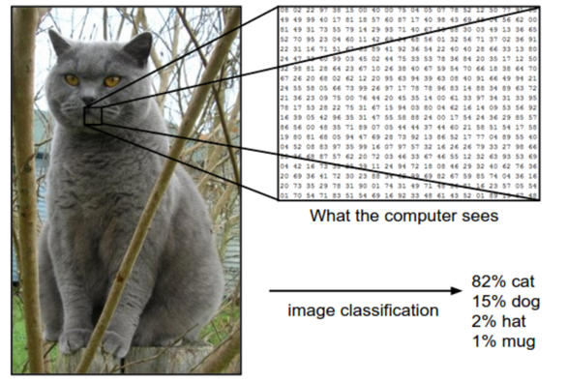
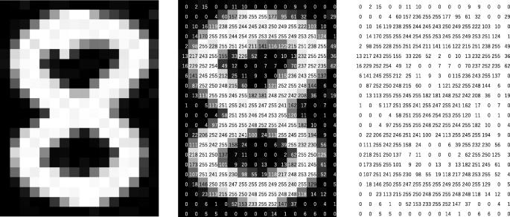
We can encode most types of data

Slide 22

We can encode most types of data

Slide 23
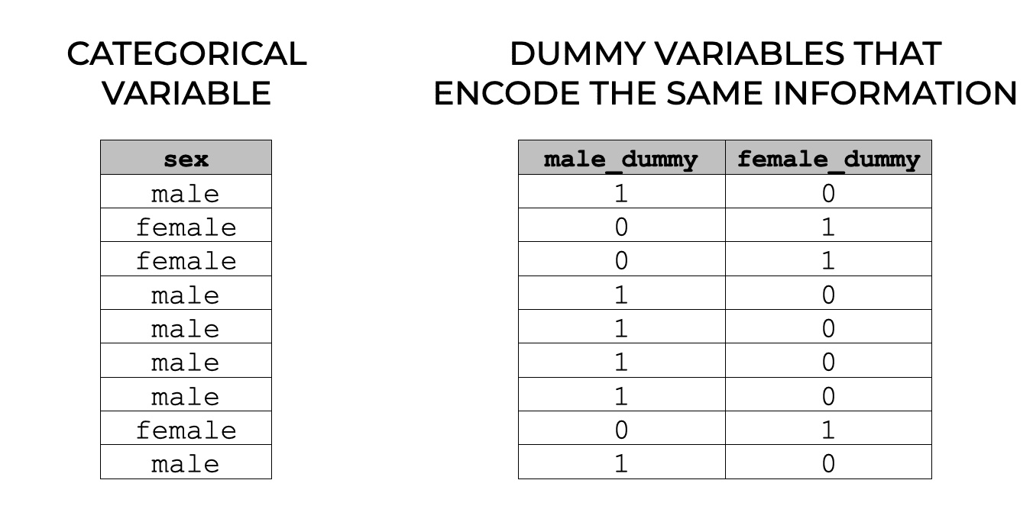
Encoding Categorical Variables
One-hot encoding creates 1 dummy variable per level

Slide 24
Encoding Categorical Variables
Dummy encoding creates (# levels – 1) dummy variables
The reference level is left out

Slide 25
Encoding Categorical Variables
Dummy encoding creates (# levels – 1) dummy variables
The reference level is left out

Slide 26
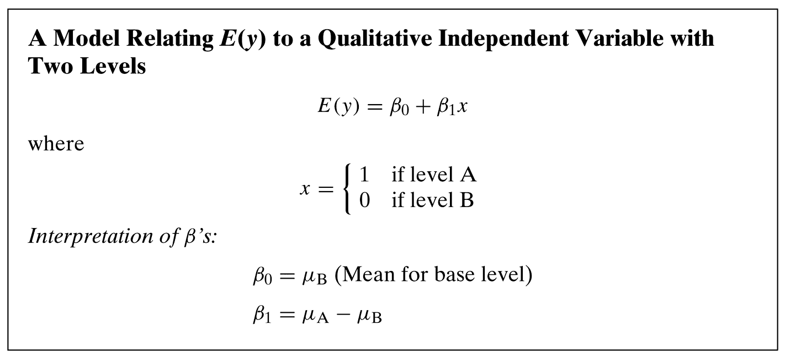
Dummy-Encoding

Slide 27
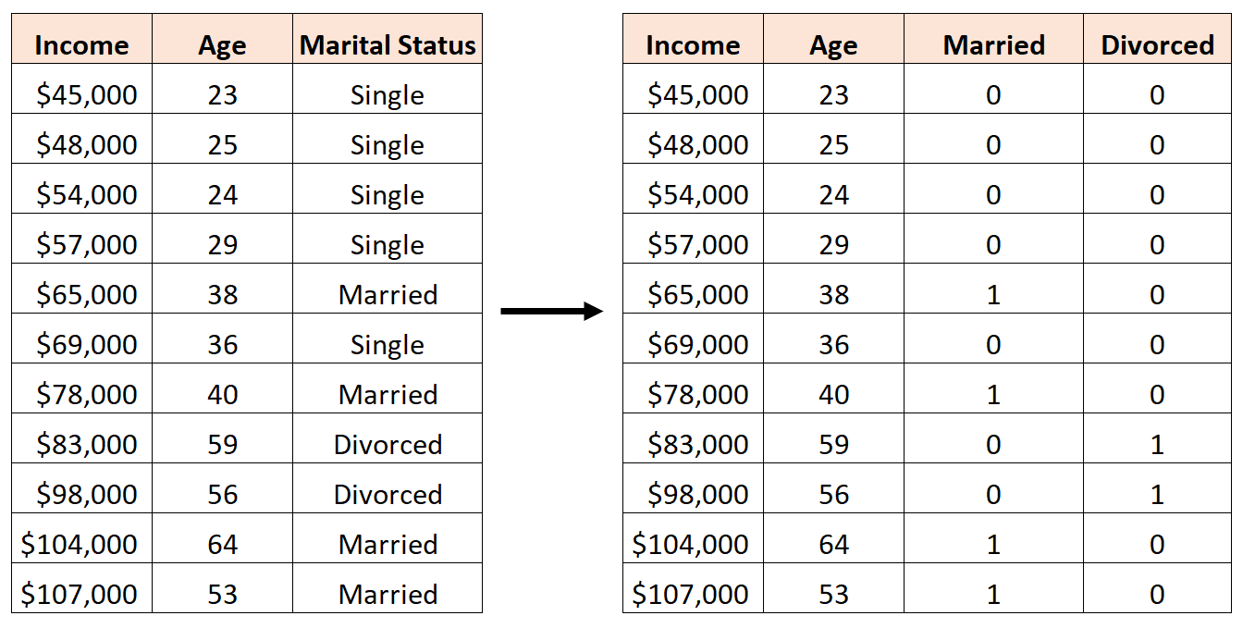
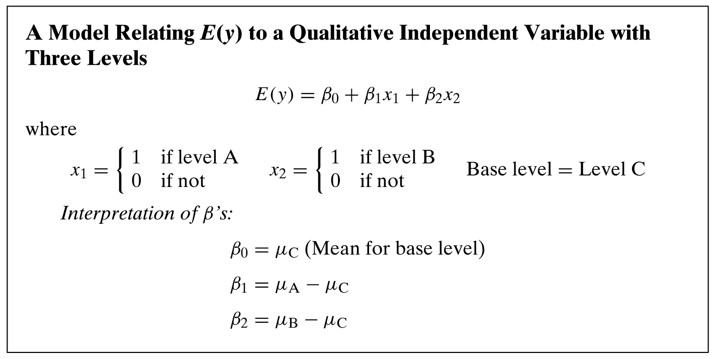
Dummy-Encoding

Slide 28
Dummy-Encoding

Slide 29
Practice

